Slide 1
Health Tweets from News Organisations
Sentiment Analysis and Topic Modelling
Nedeesha Weerasuriya

Slide 2
Summary
Data Cleaning
Text Pre-processing
Topic Modelling
LDA Model
Visualisations & Conclusions
Sentiment Analysis
Methodology
Visualisations & Conclusions
Q & A

Slide 3
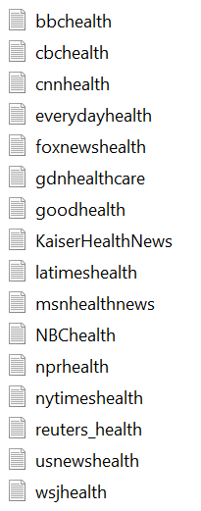
Data Cleaning
Pitfalls:
Delimiter used within tweet string: 0.3% of data points removed
Encoding varied between files
Single Dataframe:
Year
Channel
Tweet
ID
Datetime
Tweet
537996353746399233|Thu Nov 27 15:48:20 +0000 2014|Vaccines: Busting common myths http://www.cbc.ca/news/health/vaccines-busting-common-myths-1.2851270?cmp=rss
Notes:
529748838836625409|Tue Nov 04 21:35:40 +0000 2014|RT @susanamas: 1/ NEW | Immigration Minister Chris Alexander says Ottawa will offer health care under the IFHP to pregnant woman, children.…

Slide 4
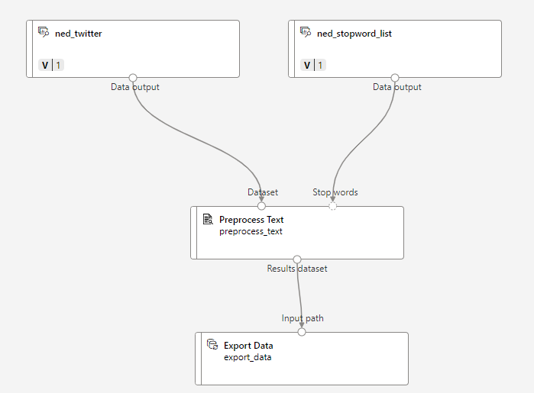
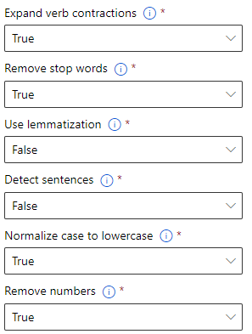
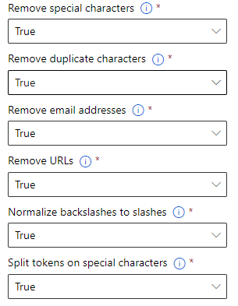
Text Preprocessing Module

Slide 5
Azure Designer & LDA
Topic Modelling
2

Slide 6
What is Topic Modelling?
Unsupervised Learning Technique
NLP procedure which scans text for words and phrase patterns
Clusters similar words/phrases into distinct topics
Latent Dirichlet Allocation (LDA) is a Topic Modelling technique available in Azure Designer
Notes:
Non-Negative Matrix Factorization

Slide 7
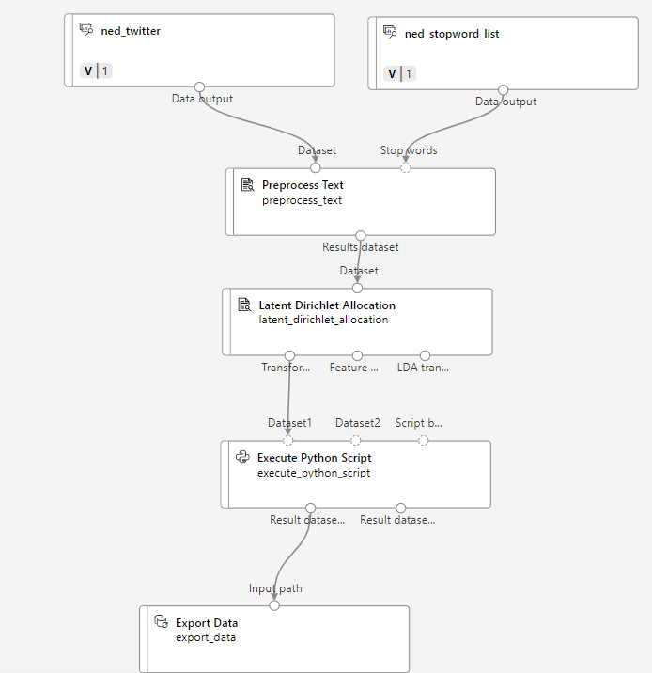
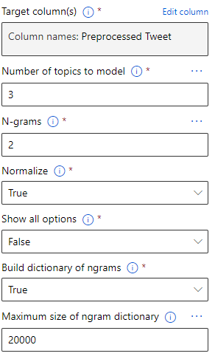
LDA Module

Slide 8
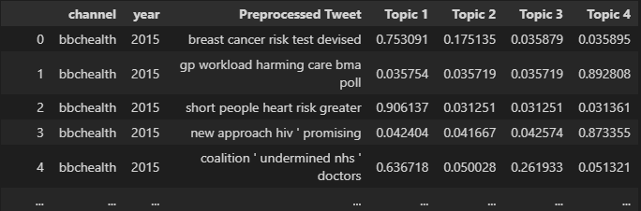
Assigning Topics by probability
Highest probability indicates topic assignment for each tweet
Created new feature, which is the average of all these highest probabilities

Slide 9
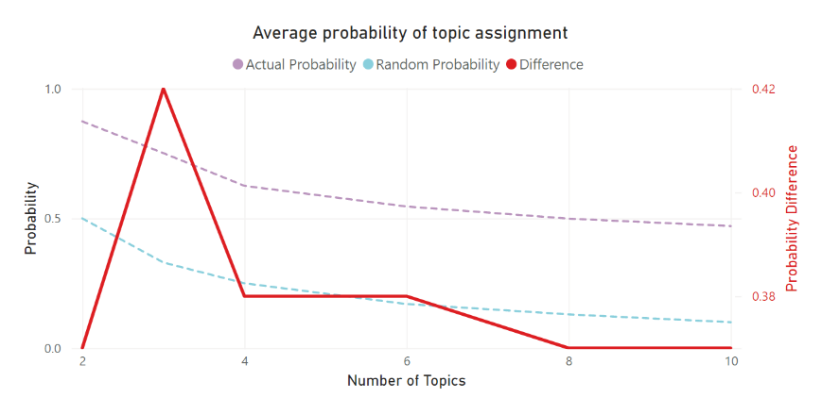
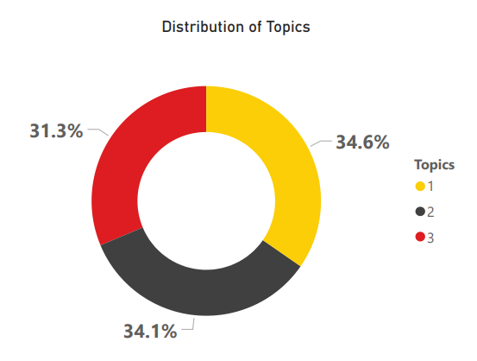
Topic Modelling: Visualisations

Slide 10
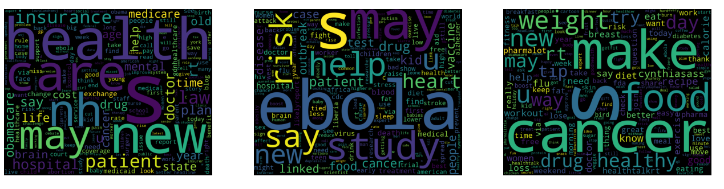
Topic Modelling: Word Cloud
Healthcare
Ebola
Consistent health risks
Notes:
Topic modelling

Slide 11
Sentiment wordcount and Vader analysis
Sentiment Analysis
3

Slide 12
Methodology
Sentiment Wordcount
Loughran-McDonald master dictionary ['Negative','Positive','Uncertainty','Litigious','Constraining']
Count number of words matching dictionary
Normalise over the number of words in the tweet
VADER Sentiment Analysis
Group dataset by channel and year independently
Run VADER analysis on grouped tweets to produce sentiment/polarity score
Sentiment score is between -1 (negative sentiment) and +1 (positive sentiment)
Notes:
The VADER sentiment lexicon is sensitive both the polarity and the intensity of sentiments expressed in social media contexts

Slide 13
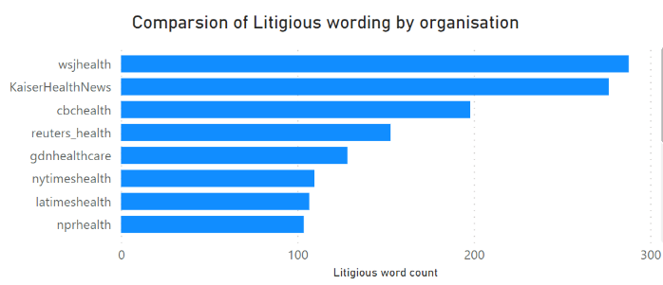
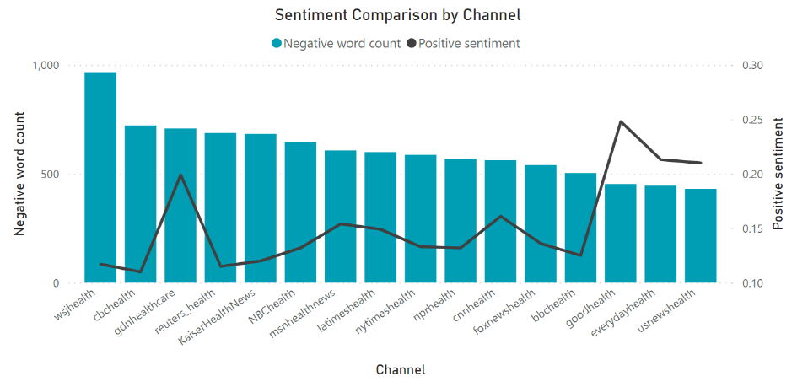
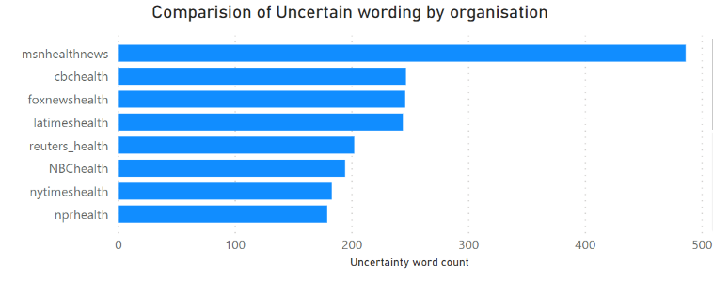
Sentiment Analysis by Channel

Slide 14
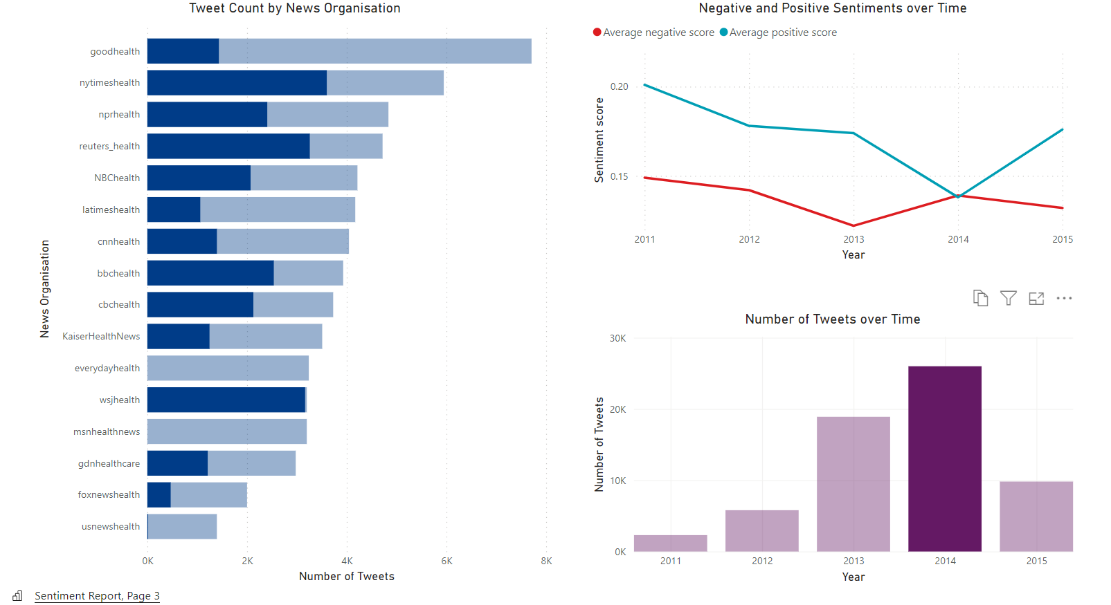

Slide 15
Considerations
Key Takeaways
News organisations have a tendency to report health news with a particular sentiment
Multiple NLP methodologies can be used in conjunction to better gain insights
Future Improvements
Incorporate lemmatisation
Keep all data after cleaning (fix delimiter issue)
Compare other Topic Modelling methods

Slide 16
Questions and Answers

